Slide 1
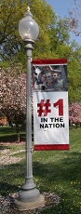


CSSE 579
Software Project Management:
Teamwork – “Old school”
Steve Chenoweth
Rose-Hulman
With helpful materials provided by Shawn Bohner
Above: Would you hire a person for your team, if they take calls during a meeting?

Slide 2

In this slide set - Main topics about teamwork in general
Phillips’s role of the Project Manager (Ch 1)
Solving problems in teams – Decision making
Examine large project team organization
approaches
  What’s the right PM role / structure?
How to stimulate cooperative learning on teams
  This is essence of team problem
  solving.
  I.e., How to get the project done!

Slide 3
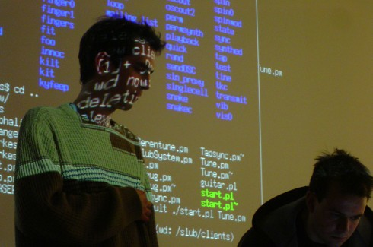
Phillips’s role of the PM
Formulate and manage software project teams.
Need to look up from your coding, at others!
Gotta have a strong, adaptable self-image.
Must be able to motivate others.
Compassion! →
Know when to lead, manage, and
get out of the way.
Put up with management “stuff”
  Like more meetings.
Notes:
Image from http://sdtimes.com/algoraves-dancing-to-live-coding/.

Slide 4
Compassion, anyone?
There are self-tests for compassion out on the internet.
  Uncertain validity.
  But, a team leader / manager needs this!
Organizations need to feel safe.
  Opposite of acting based on self-preservation.
  Trust can be built in lots of ways.
Requires moment-to-moment awareness.
  Related to the current “mindfulness” stuff.
Exemplifying “helping the group” versus “helping yourself.”
Notes:
An exam for your whole organization is at http://greatergood.berkeley.edu/quizzes/take_quiz/11
Some of the above material is from http://greatergood.berkeley.edu/article/item/three_insights_from_the_cutting_edge_of_compassion_research

Slide 5

The business problem…
How to bridge the gap to stakeholders
Technical performance needs to be translated into value for the enterprise.
  This is both a technical and managerial task.
If you specialize, as a software person, you are more likely to be on-target.
  Is it better to take people who know a business, and teach them to program?
Programming a pacemaker – How hard can that be? It’s in C, after all!
Notes:
Phillips, p 6
Image from http://www.ucdenver.edu/about/newsroom/newsreleases/Pages/UniversityofColoradoHospitalnewpacemaker.aspx

Slide 6
Phillips vs Highsmith
Phillips believes the PM needs to be very aware of all the process things, as well as about the technical progress of the project.
Cites CMM, PSP, etc., as examples of best practices.
His long list on pp 9-10 would be too long for Highsmith!

Slide 7

Phillips’ Management “Secrets”
Avoid having team members work in isolation.
Stay with your project team.
Concentrate on tasks, not tools.
Do your homework.
Is there a common theme to all of these “secrets”?
Notes:
Phillips, pp 10-11.
Image from http://www.michaelsmithlaw.com/blog/2013/08/is-your-businesss-confidential-1.html.

Slide 8

How do we use Problem Solving to get to the point of Decision-Making?
Think for 15 seconds…
What do you think?
Notes:
Work styles can be a source of irritation or even conflict. What work styles have you observed? [laid back, intensely task centered, fire-fighting, ever ready, slow and methodical, …]

Slide 9

Coping with Decisions (Challenges)
Flip a coin
Delegate it to somebody else
Wait until it goes away
Use the “squeaky wheel” approach
Wait until you get more data
Choose a temporary solution
Use a process of elimination vote
Gain consensus
Cary a big stick/dictate
Boss gets the final say
Use criteria (cheapest, best, etc.)

Slide 10
Project Management is Decision Making
What has to be done and where?
Why should it be done?
How well must it be done?
When is it required? In what sequence?
How much will it cost?
What are the uncertainties?
Who should do the job?
How should people be organized into teams?
How shall we know?
Scope
Justification
Quality
Schedule
Budget/Cost
Risk
Human Resources
Communication/Interpersonal Skills
Information Dissemination/ Communication

Slide 11
6 Phases of the Decision-Making Process
PHASE | DESCRIPTION | LEARNING STYLE
Phase I: Situation | Discovery phase. The team investigates, discusses, clarifies, and defines the situation. Important for team to understand root causes and evidence that led to the need for a decision. | Assimilator
Phase II: Situation | Continuation of Phase I. Characterized by brainstorming and searching for new ideas and alternatives decision for resolving the situation, which should lead to generation better options for the decision. Above all, the team needs to avoid a rush to judgment. | Diverger
Phase III: Ideas to action | Define the criteria for evaluating the alternative decisions. This involves identifying the advantages and disadvantages of each alternative. Whatever approach is used, the result should be a ranking of alternatives from most desirable to least desirable. | Converger
Notes:
11
What are the four learning styles that support the phases of decision making? [Assimilator, diverger, converger, and accommodator]

Slide 12
6 Phases of the Decision-Making Process
PHASE | DESCRIPTION | LEARNING STYLE
Phase IV: Decision | Begins once the alternative is chosen. This is the planning phase for the project team. The team action plan determines tasks, resources, and timelines that are required to implement the decision. This phase requires a concerted effort to obtain buy-in from all affected parties. | Converger
Phase V: Decision | Learning opportunity for the project team. The team identifies what did and did not work, as well as areas evaluation in which it can improve and how to do so. The value planning of this discussion lies in the team’s willingness to be honest and straightforward with one another. | Accommo-dator
Phase VI: Evaluation | Focuses on the quality of results. The team evaluates the situation: Was the situation improved satisfactorily, of outcome or will another round be required? Was the situation and process defined correctly, or is revision required? Did the process work as expected, or will it need adjustment for the next attempt? | Assimilator
Notes:
12
What are the four learning styles that support the phases of decision making? [Assimilator, diverger, converger, and accommodator]

Slide 13
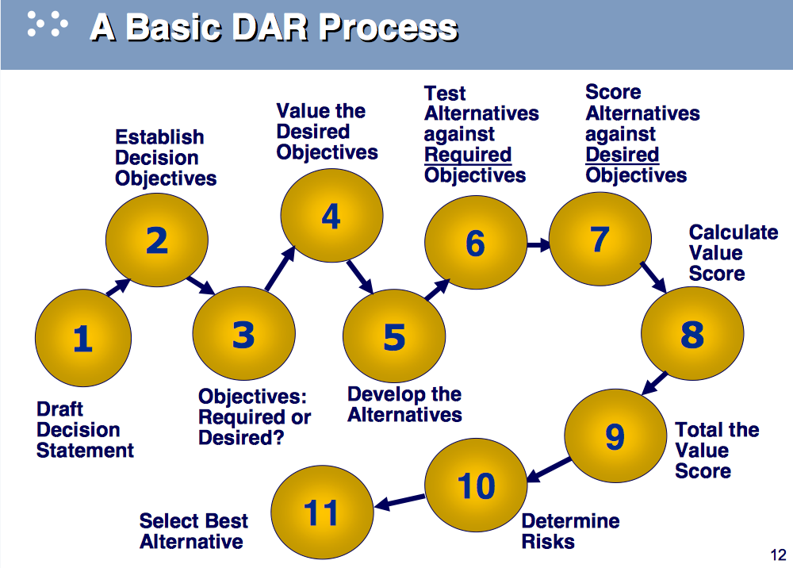
Similar process – SEI’s “DAR”
“Decision Analysis and Resolution”
Notes:
See http://resources.sei.cmu.edu/asset_files/Presentation/2004_017_001_23862.pdf.

Slide 14

Heart of Decisions is Problem Solving
Problem as defined by Webster:
“1. a question raised for inquiry, consideration, or solution
2. an intricate unsettled question. A source of perplexity, distress, or vexation”
Rational problem solving: A deviation between a should and an actual for which a cause is unknown and of concern.

Slide 15
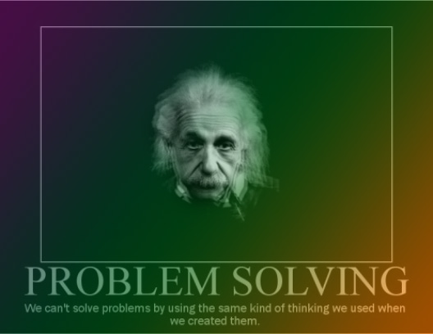
Einstein’sizm ☺
Notes:
Soooo true!

Slide 16
Five Steps to Solving a Problem
Define the problem and the owner
Gather relevant data and analyze causes
Generate ideas
Evaluate and prioritize
ideas
Develop an action plan
Note the separation between “Generate ideas” and “Evaluate…”
Source: Creative Problem Solving and Opportunity Finding
J. Daniel Couger, 1995
Notes:
16
What are the five steps to solving a problem? [Define the problem & the owner, Gather relevant data and analyze causes, Generate ideas, Evaluate and prioritize ideas, and develop action plan]

Slide 17
Example: Solve Supplier Problem
Problem Description: Our standard preferred supplier of camera bodies and housings has been purchased by one of their competitors in a hostile takeover. As a result the purchase/quantity agreements we had in place have now been reopened by the new owner with the intent of renegotiating new agreements.
Impact: Performance impacted due to production costs exceeding the measure of $30/unit.
Alternatives
  Renegotiate all purchase orders with the supplier representatives
  Find entirely different supplier
  Change part specs by using less expensive materials
  Decrease lens cost by renegotiating terms for volume discounts
Recommendation

Slide 18
Organize the Solution Alternatives
Problem Statement:
Our standard preferred supplier of camera bodies and housings has been purchased by one of their competitors in a hostile takeover. As a result, the purchase/quantity agreements we had in place have now been reopened by the new owner with the intent of renegotiating new agreements.
 |  | × Alternatives Ø
IMPACT ON: | Problem | 1 | 2 | 3 | 4
C o s t |  |  | $15K – travel to view facilities of potential new vendor | 60 hrs | 35 hrs
S c h |  | 1 week | 3 weeks | 2 weeks reengineering | 1.5 weeks
P r o d | Production cost increase of $30/unit | Maintain current component knowledge with current vendor | However there is a quality risk due to unknown supplier capabilities | Perceived quality of camera by consumer down by 2 points | Risk that lens inventories will be higher than demand for cameras
Groups: Which solution has the best potential? Why?

Slide 19
My Recommendation: Alternative #1
But your view may differ!
The reason is that we have established and maintained a strong, productive relationship with the engineering and manufacturing people who produce the camera bodies.
To preserve this relationship and solve the problem, we want to forge a relationship with the purchasing agents of the current supplier.

Slide 20
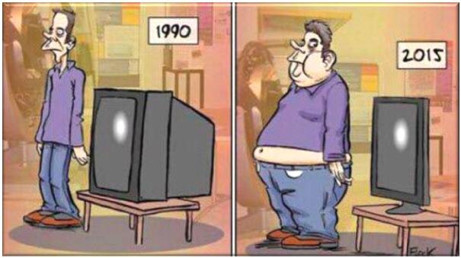
How do we deal with bulky Projects?
And, why is it we Americans are gaining weight?
(Just out of curiosity…)

Slide 21
(If you can solve this problem, you should get a Nobel prize!)
NIH says:
Lack of energy balance.
An inactive lifestyle.
Environment:
  Lack of easy access to places to exercise.
  Work schedules.
  Oversized food portions.
  Lack of access to healthy foods.
  Food advertising.
Genes and family history.
Health conditions (hormones, etc.)
Medicines.
Emotional factors.
Stopping smoking!
Age.
Pregnancy.
Lack of sleep.
Working on software projects has become equally tough!
Notes:
From http://www.nhlbi.nih.gov/health/health-topics/topics/obe/causes.

Slide 22
Multiple-Team Projects
What happens when the project is so large that one project team cannot handle it?
  Break the project into parts
  Recruit and assign more senior people
  Beg out of project and look for one your size…
Organize around different team approaches
  Project Office
  Core team
  Super team
Notes:
What are the three Multiple-Team Project organization approaches? [Project office, core team, and super team]
What is a Multiple team project? These are development project which involve more than one team. For example, these days a lot of teams from different parts of the world work together to implement a product. If you take something like Windows, it just does not involve a single team working out of Redmond… There are multiple teams which focus on different things, which have different identities,different management structures(no process versus heavy on everything), different life cycles, different processes, different ways of gathering requirements, different ways of handling scope… the question is how do you integrate these various teams, and come up with ways to organize, scope, plan and manage such projects while maintaining the individual culture throughout..
A common temptation here is to let each team do its own stuff and then have a nice integration task at the very end.. Do you think this will succeed?
Ideally you want to choose a management structure based on the project. Try and choose a structure that best meets the needs of the project…
Try and define a definitive life cycle for the project. You need to come up with milestones, and phases for the various teams. These can be used to drive the project plan at a later stage. Make sure everybody on all teams understands what each phase or milestone is above - circulate definitions if necessary.. It is vital they understand what their roles are , what responsibilities they have before you start planning..
Define how requirements are going to be gathered
Define how scope changes are going to be handled.. Typically two levels of approval are required - one at the level of a team. It might be the case that teams disagree on how to handle a particular scope change. Some will accept it, others will reject it The other approval is required at the project level and you need to try and reconcile the conflicting decisions.
Decide on a meeting structure. You don’t want to add too much management overload
Decide on Reporting.. You need reports to keep an eye on scope and progress of the project and to keep an eye on whether you can complete everything you need to within the time available. You need to ensure that you balance this just right. Too much reporting would essentially be a waste of time, but if you don’t do enough then the project may run into trouble.
Have seconds - since you cannot attend all meetings and be involved in all decision making processes as a PM you designate somebody else to represent you. But don’t make this into a regular habit as you may lose your own authority within the team.
Make sure you build an integrated plan and be willing to share resources across teams.

Slide 23
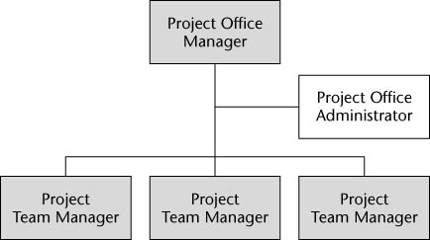
Project Office
Layer of management support and
coordination between the teams
  Temporary structure for of a big projects
Program Office Manager (POM)
is a coordinating role
  Each team operates
  independently reporting to POM
  Consolidates reporting to upper management
  Scales really well to large projects and teams
Challenges
  Lots of pressure on the project office
  Must remain mindful of overall vision of the project
  Must avoid letting individual interests impede overall success
  It doesn’t handle risk all that well
Notes:
In the program office configuration, large teams report to upper management through what? [the Program Office or program office manager]

Slide 24
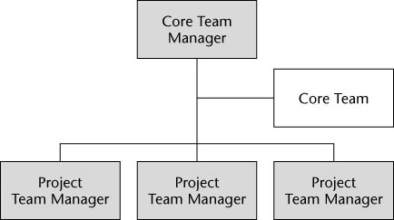
Core Team
Similar to the PO, but it has
an advisory committee
Subject matter experts work
with teams as advisors
  Temporary Structure
  Core team produces overall plan
  Good for resolving conflicts, handling risks, and coordinating work of several teams
  Teams retain their individuality
Problem: May not scale well to large projects
  Must manage competing priorities just like in project office
  Not very good for professional development
    Difficult to train next generation of core team members
Notes:
Core teams are subject matter experts who provide advice to the project teams. What does the Core Team do for the Core Team Manager? [Core team works with the core team manager to produce an overall plan & resolve conflicts]

Slide 25
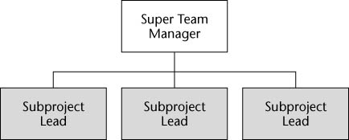
Super Teams
Super teams like most projects
just bigger
  Integrate various teams
  into a huge super team
  Divide them into groups that
  focus on a particular aspect
Single PM responsible
  Unified process
  Unified way of handling risks
  Common plan and a standard set of practices
Can handle risks and conflicts the best of the lot, but cannot handle huge projects
Standardizing everything might be tough to do. Individuality may be lost.

Slide 26
Selecting the PM Structure

Slide 27
Organizational Hurdles for Team Performance
Performance Problems
Low profits/high costs
Low productivity
High rework
Frequently down network
Poor customer service
Individual Behaviors
Organizational Response
Poor morale/attitude
Lower work quality
Job dissatisfaction
Higher turnover
Sabotage
Downsizing
Penalties
Less training
Salary/bonus reduction
Use of temporary labor
Notes:
What organizational hurdle results in low productivity and high rework? [Performance problems]
Performance/Measurement Challenges in IT Organizations
Insufficient context to judge reasonableness of goals
No clear linkage among strategic goals and results
Inability to qualitatively assess results
Loose standards for “good” performance
Over-reliance on output, process, and input measures
No baseline or trend data
Lack of confidence that performance data is credible — no verification, validation, or data limitation information
Outmoded data management systems
Limited use of performance information for decision making
Lack of data on cross-cutting programs
No formal evaluations

Slide 28
Teams want cooperative learning
Cooperative learning is a type of active learning where people work together in small groups to facilitate their own and the other members’ learning.
Cooperative learning has a deep theoretical basis. Since the first research study in 1898, there have been nearly 700 relevant studies.
Cooperative learning generally results in higher achievement and productivity by all students, and deeper learning with longer retention.

Slide 29
Details - cooperative learning
Barbara Millis describes three premises underlying cooperative learning.
A respect for the individual differences among the students – intellectual, educational, social, and ethnic – and the belief that they all possess the potential to succeed in the class.
Cooperative learning is an active and constructive process. In constructive learning, students create and build their own knowledge.
Cooperative learning is a social activity with a shared sense of community.
The benefits of social learning have been studied by many well-known educational theorists. One of the early relevant theories is the Social Development Theory of Lev Vygotsky:
Vygotsky believed that students learned best when interacting with others, especially if the others were more competent in the area being explored. The support of others allowed the student to progress farther than he/she would have alone.
Vygotsky is famous for his portrayal of this gap between what a student might learn alone, and what the student might learn with support, a gap that he called the Zone of Proximal Development (ZPD).
A later theory, related to that of Vygotsky, is the Social Learning theory of Albert Bandura. Bandura emphasized the importance of learning through the observation and modeling of the behavior of others. This is a natural outgrowth of cooperative learning.

Slide 30
Teams want cooperative learning
Cooperative learning involves students working in teams toward a common goal. Although there are many viewpoints as to what constitutes cooperative learning, it generally incorporates these elements:
Positive interdependence: Team members rely on each other to achieve the common goal.
Face-to-face interaction: Team members do most of the work together. They provide assistance, encouragement and feedback to the other team members.
Individual accountability and personal responsibility: Each team member is responsible for doing his/her share of the work, and is expected to master all necessary material.
Interpersonal and small-group skills: Team members use effective communication and conflict-management skills.
Group processing: Team members set common goals, reflect on team accomplishments and make adjustments as necessary.

